Slide 1
Implementing Entity Framework with MVC Jump Start
Adam Tuliper | Technical Evangelist, Microsoft
Christopher Harrison | Content Developer, Microsoft

Slide 2

Meet Adam Tuliper | ‏@AdamTuliper
Technical Evangelist, Microsoft
Focused on Web, Data, Gaming, and Cloud Technologies
Emphasis on secure development practices
20 years of industry experience as software architect
Enterprise, startups, public sector, defense, healthcare, financial industries
channel9.msdn.com/Blogs/AdamTuliper
Video content
adamtuliper.com

Slide 3

Meet Christopher Harrison | ‏@geektrainer
Content Developer
Focused on ASP.NET and Office 365 development
Microsoft Certified Trainer
Regular presenter at TechEd
Long time geek
Still misses his Commodore 64
Periodic blogger (blog.geektrainer.com)
Marathoner, husband, father of one four legged child

Slide 4
Setting Expectations
Target Audience
Web Developers
Experience with C#
Suggested Prerequisites/Supporting Material
Introduction to MVC

Slide 5
Join the MVA Community!
Microsoft Virtual Academy
Free online learning tailored for IT Pros and Developers
Over 2.6 million registered users
Up-to-date, relevant training on variety of Microsoft products
“Earn while you learn!”
Get 50 MVA Points for this event!
Visit http://aka.ms/MVA-Voucher
Enter this code: MVCEntityFrmwrk (Expires 2Mar15)

Slide 6
Github Repository
Has all demo files along with slides from this session
http://github.com/MicrosoftLearning/EntityFramework

Slide 7
Course Topics
Implementing Entity Framework with MVC
01 | Introduction to Entity Framework | 04 | Managing the database
02 | Beginning Code First | 05 | Managing transactions
03 | Managing Relationships | 06 | Integrating extra features and looking forward

Slide 8
01 | Introduction to Entity Framework
Adam Tuliper | Technical Evangelist, Microsoft
Christopher Harrison | Content Developer, Microsoft

Slide 9
Module Overview
Architecture
Intro to Code First
Generating EF Classes

Slide 10
Architecture

Slide 11
What is the Entity Framework
It IS an ORM
What’s an ORM?
Maps your database types to your code types
Avoids repetitive data access code
Customer
CustomerInfo.cs
Customer
Customer.cs
ShipTo

Slide 12
EF Platforms
EF 6.1 Any project that is full .NET 4+
All Microsoft SQL Databases
Web Forms, MVC, WPF, WCF, Web API, Web Forms
Newer ones to include Azure Table Storage, Redis, Linux, etc
Supported ADO.NET Providers
https://msdn.microsoft.com/en-us/data/dd363565.aspx
Notes:
Talk about nuget packages, upgrading, rolling back, etc.
IBM supplies ADO.NET data providers for access to DB2, Informix, and U2 databases.
Any ADO.NET Data Provider?

Slide 13
Some supported features
Full ORM to map objects to code
Async Queries
Connection Resiliency (retry)
Stored Procedure mapping
Reverse engineering existing database
Using code to create database (code first)
Concurrency detection
Enum & Spatial Data support

Slide 14
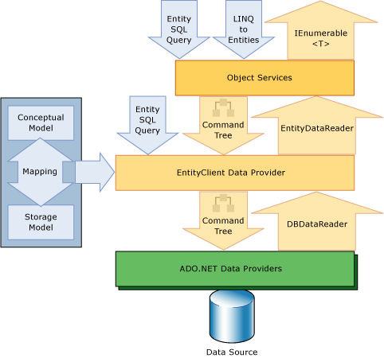
High level view
Simplified View
LINQ to Entities
Convert to query, execute
Map results to entities
EF System Components

Slide 15
Installing Entity Framework
EF6 Requires Visual Studio 2010 or greater
NuGet
Install-package EntityFramework
Comes as part of
MVC, Web Forms, Web API templates if Identity is used

Slide 16
NuGet Primer
Install-Package EntityFramework
Latest non-beta
Install-Package EntityFramework –pre
pre release version
Uninstall-Package EntityFramework
Update-Package EntityFramework –reinstall (all projects)
Update-Package EntityFramework -ProjectName MyProject
Notes:
Update-Package -Reinstall (reinstall all packages in all projects)

Slide 17
Installing and Managing Entity Framework Binaries
Notes:
Create MVC app without identity, Install-package entityframework
Create MVC app with identity, show it already exists. Show how to upgrade, remove, reinstall.
Update-Package EntityFramework (maybe –pre if theres time)

Slide 18
Intro to Code First

Slide 19
Code First
The term ‘code first’ – a misnomer?
Maps your POCO classes to database
Uses at a minimum a DbContext and an entity (ie a class)
public class MusicStoreDbContext : DbContext
{
public DbSet<Album> Albums{ get; set; }
}
DbContext
public class Album
{
public string Name { get; set; }
public decimal Cost{ get; set; }
}
POCO (Entity)

Slide 20
Basic code first and scaffolding
Notes:
Create a new console app, then we’ll do web.
Install-package EF
Add class
public class Album
{
public int AlbumId { get; set; }
public int GenreId { get; set; }
public int ArtistId { get; set; }
public string Title { get; set; }
public decimal Price { get; set; }
public string AlbumArtUrl { get; set; }
}
public class MusicContext : DbContext
{
public DbSet<Album> Albums { get; set; }
}
4.
Run the app. Explain the database is created because of connection string in the name in DbContext
5. If DbContext doesn’t have a connect string, we look for the name of the context class connection string.
If that’s not found, we try to create SQLExpress, local db 12, local db 11
6. Add a connection string and show that new database
using (var context = new MusicContext())
{
var albums = context.Albums.ToList();
Console.WriteLine(albums.Count());
context.Albums.Add(new Album() { AlbumArtUrl="http://no.com",
AlbumId=1,
ArtistId=1,
GenreId=2,
Price=9.99m,
Title="My Album"});
context.SaveChanges();
albums = context.Albums.ToList();
Console.WriteLine(albums.Count());
}

Slide 21
How does EF connect to your db?
Could be cloud, App_Data folder, Intranet, Internet, other folder
Connect string named in DbContext class
Read connect string
Open Connection
You should always specify a connection string name when you intend to use a connection string in the config file. This ensures that if the connection string is not present then Entity Framework will throw rather than creating a new database by convention.
public MusicContext() : base("MusicStoreConnection")
{
}
Use context class name to look for connect string in web.config
Read connect string
Open Connection
<add name="MusicStoreContext" connectionString="Data Source=(localdb)\v12.0;.." providerName="System.Data.SqlClient" />
No connect string.
Start database checks
Look for SQL Express
Look for (localdb)\\11
Look for (localdb)\\mssqllocaldb
Notes:
DB name will be that of the connection string name, ie
Data Source=(localdb)\mssqllocaldb;Initial Catalog=MusicStoreConnection;Integrated Security=True
public MusicContext()
: base("MusicStoreConnection")
{
}
<connectionStrings>
<add name="MusicStoreContext" connectionString="Data Source=(localdb)\v12.0; Initial Catalog=MusicStoreDev; Integrated Security=True; MultipleActiveResultSets=True; AttachDbFilename=|DataDirectory|MusicStoreDev.mdf" providerName="System.Data.SqlClient" />
</connectionStrings>

Slide 22
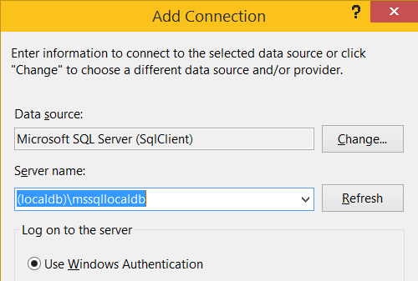
Helpful Hint
Connecting to LocalDb be aware of instance names
Typically v11.0, mssqllocaldb
ProjectsV12 is created by data tools, ignore
Connection string
Data Source=(localdb)\mssqllocaldb;
Get versions / instances via
sqllocaldb i
sqllocaldb v

Slide 23
Viewing queries
context.Database.Log = s => Console.WriteLine(s);
Glimpse
Install-package glimpse.mvc5
install-package glimpse.ef6
Interceptors
Goes in .config
<interceptors>
<interceptor type="System.Data.Entity.Infrastructure.Interception.DatabaseLogger, EntityFramework">
<parameters>
<parameter value=“MyAppsOutput.txt"/>
<parameter value="true" type="System.Boolean"/>
</parameters>
</interceptor>
</interceptors>
Notes:
<interceptors>
<interceptor type="System.Data.Entity.Infrastructure.Interception.DatabaseLogger, EntityFramework">
<parameters>
<parameter value=“MyAppsOutput.txt"/>
<parameter value="true" type="System.Boolean"/>
</parameters>
</interceptor>
</interceptors>

Slide 24
Viewing queries and connection info
Notes:
//View queries
context.Database.Log = s => Console.WriteLine(s);
//Log connection
Console.WriteLine(context.Database.Connection.ConnectionString);
Using glimpse
Install-package glimpse.mvc5
install-package glimpse.entityframework
Inside the <entityFramework> element
<interceptors>
<interceptor type="System.Data.Entity.Infrastructure.Interception.DatabaseLogger, EntityFramework">
<parameters>
<parameter value=“MyAppsOutput.txt"/>
<parameter value="true" type="System.Boolean"/>
</parameters>
</interceptor>
</interceptors>

Slide 25
Generating EF classes

Slide 26
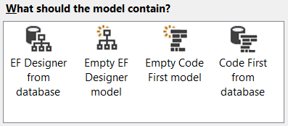
Ways to generate
Hand coding classes
Use a visual designer
Add->ADO.NET Entity Data Model
Database First Entity Designer
Notes:
Discuss manual method, deprecating the designer, and revere engineering

Slide 27
Generating database and reverse engineering
Notes:
Look briefly at dialog
Choose an existing database with music store information in it and reverse engineer it.
Discuss we’ll talk about the database more in module 4

Slide 28
Resources
EF Resources
https://msdn.microsoft.com/en-us/data/ef.aspx
EF Team Blog
http://blogs.msdn.com/b/adonet/

